Slide 1

Deep learning
Week 4, Lecture 4
Muhammad Saqib Sohail
Fall 2025

Slide 2
Convolution Neural Networks (CNNs)

Slide 3
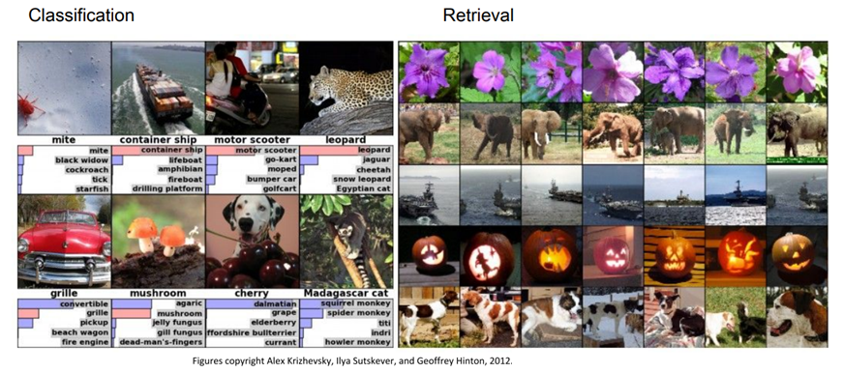
CNNs power modern computer vision application

Slide 4
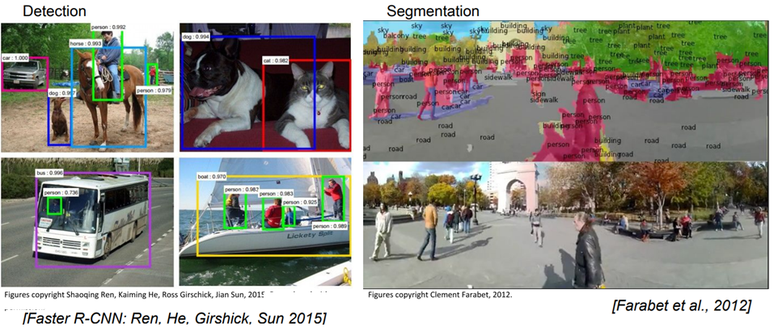
CNNs power modern computer vision application

Slide 5
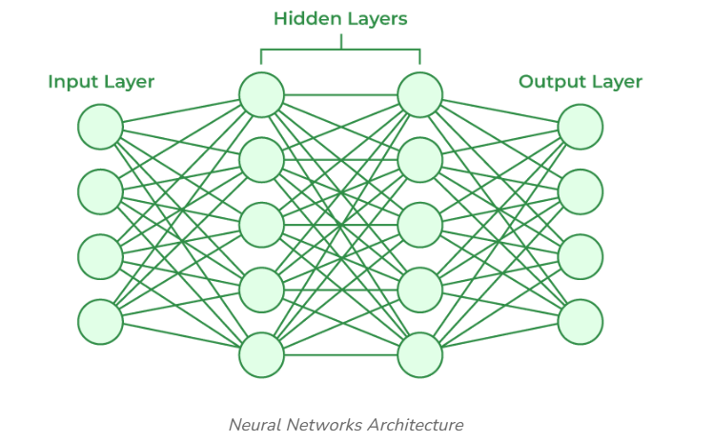
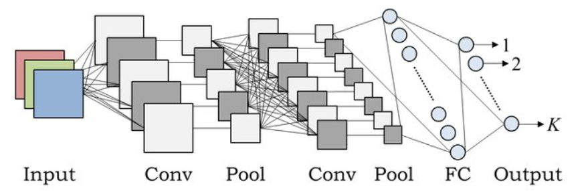
Why CNNs?
Images: high-dimensional data → fully connected networks are inefficient (say you have a 1024 x 1024 image)
CNNs exploit spatial structure (local patterns, nearby pixels)
CNNs = backbone of modern computer vision (image classification, detection, segmentation)

Slide 6
Why CNNs?
CNNs are a type of deep learning model designed specifically to process grid-like data structures, such as images and videos
Advantage
Efficiently capture spatial hierarchies in data (e.g., edges, textures, and complex patterns)
Reduce the number of parameters compared to fully connected networks, making them more computationally efficient for large inputs like images

Slide 7
CNN vs. Feedforward Neural Network
FFNN: every neuron in hidden layer connected to every input → too many parameters
CNN: local connectivity, weight sharing → efficient and scalable
Intuition: CNN learns “filters” that detect useful features

Slide 8
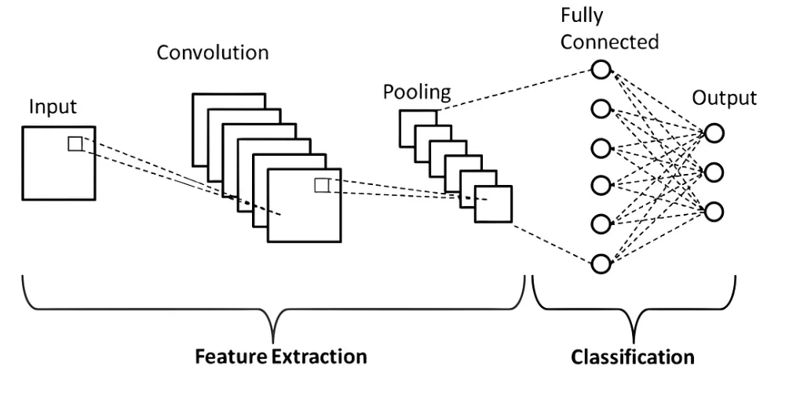
CNN Architecture Overview
Typical pipeline:
Convolution → computes weighted sums with filters (linear operation), also called kernels, to extract patterns like edges, corners, or textures
Output: Feature map (what features the filter is detecting)
Activation → immediately after convolution to introduce non-linearity (e.g., ReLU)
Output: Activation map (which features are active and pass forward)
Pooling → applied after activation to reduce spatial resolution and retain important features
Examples: Max Pooling (selecting the maximum value in a region), min pooling, average pooling
Output: Pooled activation maps
Repeat conv–act–pool blocks as needed
Flatten → fully connected layers → output (e.g., Softmax for classification)

Slide 9
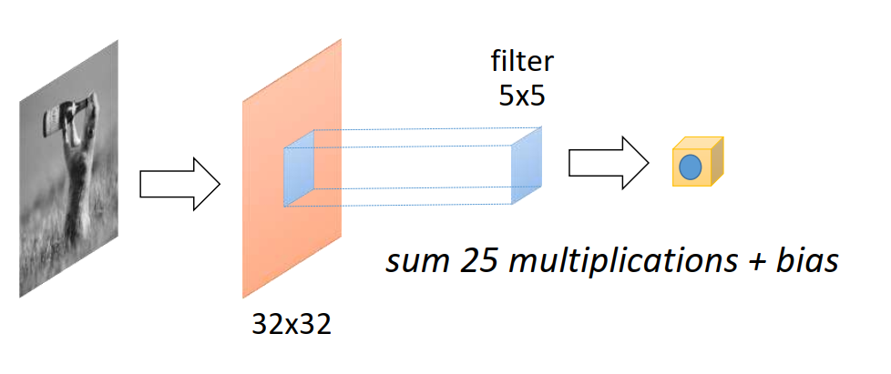
Convolution operation
Kernel (filter) slides over input image
Performs dot product → produces feature map
Small kernel (e.g., 5×5) captures local patterns
Weight sharing = fewer parameters than FC layer

Slide 10
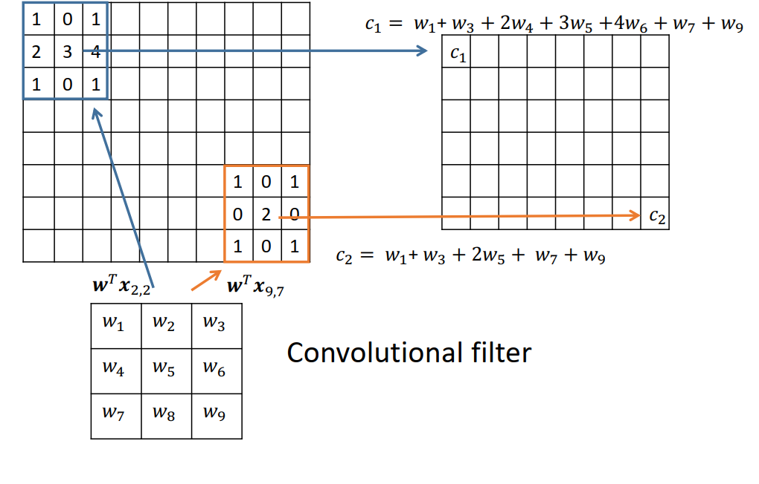
Convolution operation

Slide 11
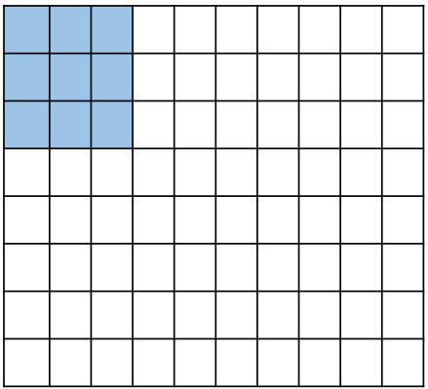
Stride
Stride: how far filter moves at each step
Large stride → smaller output map
Basic convolution slides the filter on the image one pixel at a time
Stride=1

Slide 12
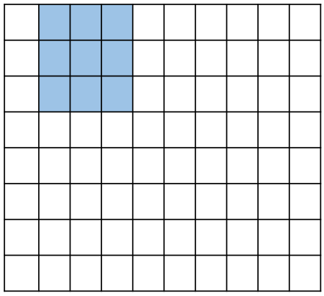
Stride
Stride: how far filter moves at each step
Large stride → smaller output map
Basic convolution slides the filter on the image one pixel at a time
Stride=1

Slide 13
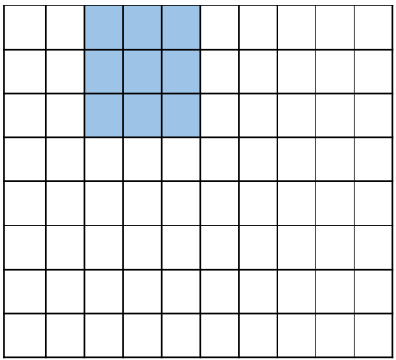
Stride
Stride: how far filter moves at each step
Large stride → smaller output map
Basic convolution slides the filter on the image one pixel at a time
Stride=1

Slide 14
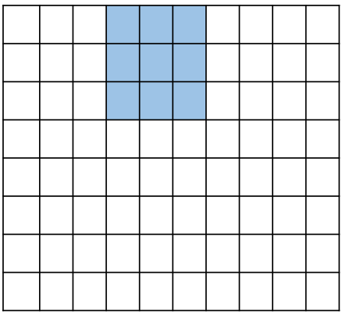
Stride
Stride: how far filter moves at each step
Large stride → smaller output map
Basic convolution slides the filter on the image one pixel at a time
Stride=1

Slide 15
Stride
Stride: how far filter moves at each step
Large stride → smaller output map
Basic convolution slides the filter on the image one pixel at a time
Stride=2

Slide 16
Stride
Stride: how far filter moves at each step
Large stride → smaller output map
Basic convolution slides the filter on the image one pixel at a time
Stride=2

Slide 17
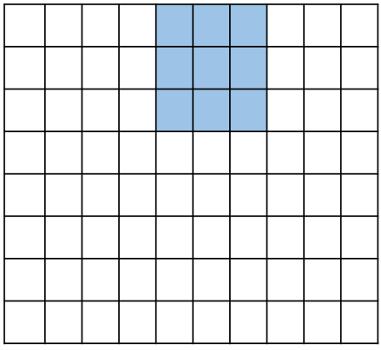
Stride
Stride: how far filter moves at each step
Large stride → smaller output map
Basic convolution slides the filter on the image one pixel at a time
Stride=2

Slide 18
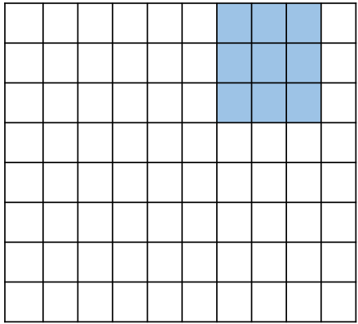
Stride
Stride: how far filter moves at each step
Large stride → smaller output map
Basic convolution slides the filter on the image one pixel at a time
Stride=2

Slide 19
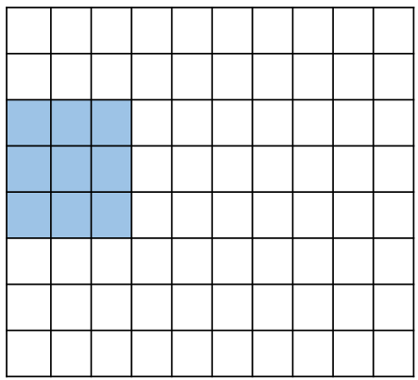
Stride
Stride: how far filter moves at each step
Large stride → smaller output map
Basic convolution slides the filter on the image one pixel at a time
Stride=2

Slide 20
Stride
Stride: how far filter moves at each step
Large stride → smaller output map
Basic convolution slides the filter on the image one pixel at a time
Stride=3

Slide 21
Stride
Stride: how far filter moves at each step
Large stride → smaller output map
Basic convolution slides the filter on the image one pixel at a time
Stride=3

Slide 22
Stride
Stride: how far filter moves at each step
Large stride → smaller output map
Basic convolution slides the filter on the image one pixel at a time
Stride=3

Slide 23
Activation Function
Output of convolution layer (feature map) is passed through an activation function
This gives an activation map

Slide 24
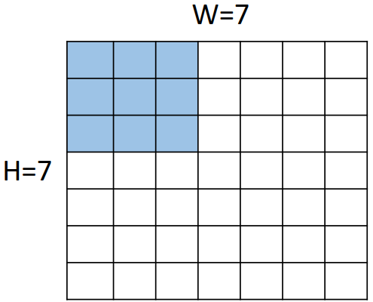
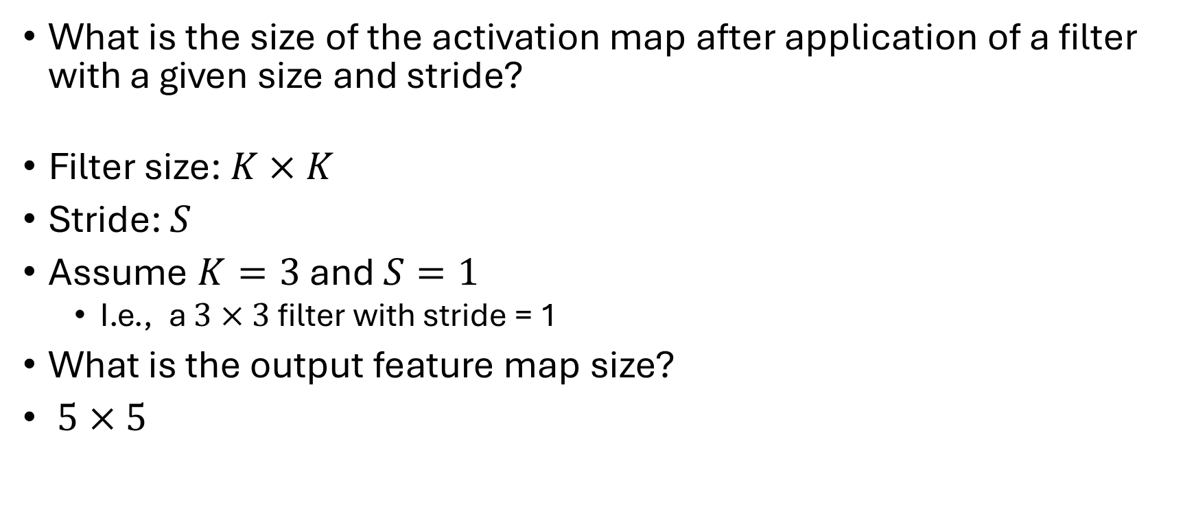
Activation map size
What is the size of the activation map after application of a filter with a given size and stride?
Filter size: $K×K$
Stride: $S$
Assume $K=3$ and $S=1$
I.e., a $3×3$ filter with stride = 1
What is the output feature map size?
$5×5$

Slide 25
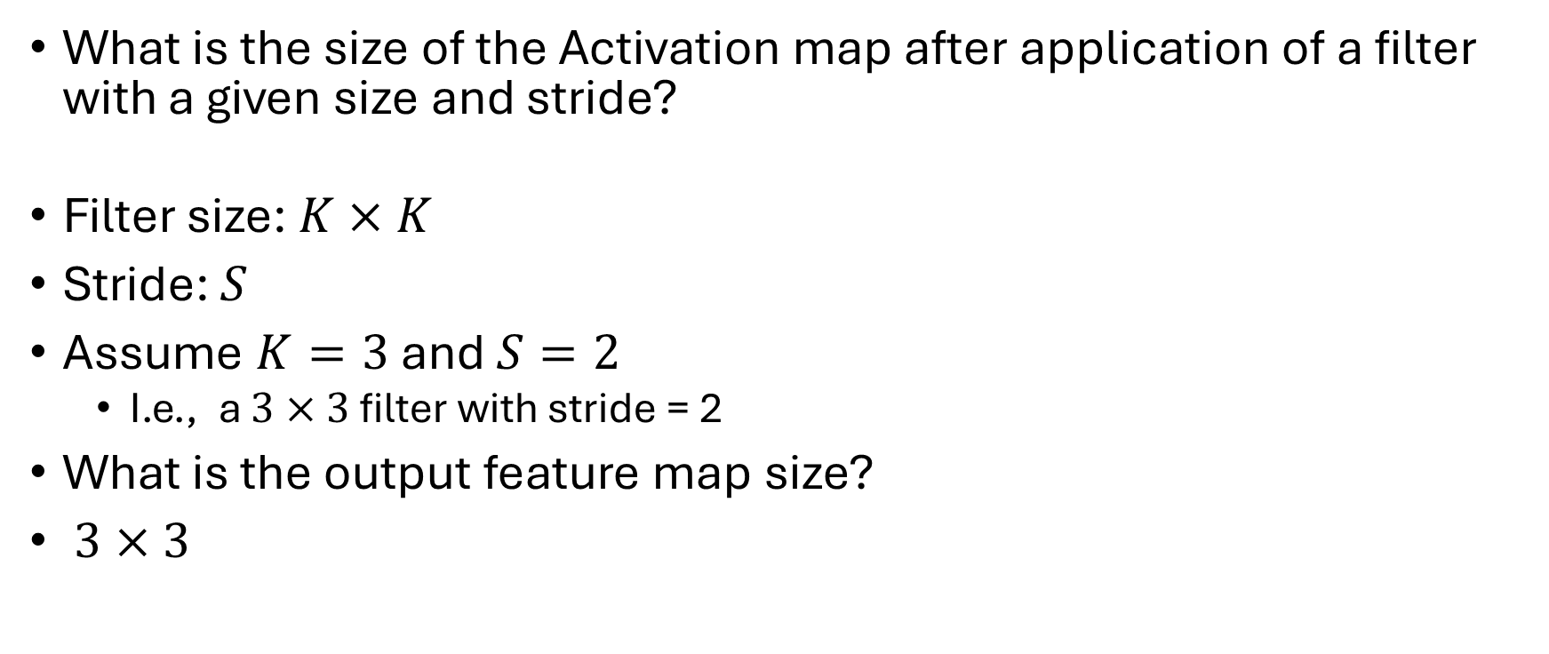
Activation map size
What is the size of the Activation map after application of a filter with a given size and stride?
Filter size: $K×K$
Stride: $S$
Assume $K=3$ and $S=2$
I.e., a $3×3$ filter with stride = 2
What is the output feature map size?
$3×3$

Slide 26
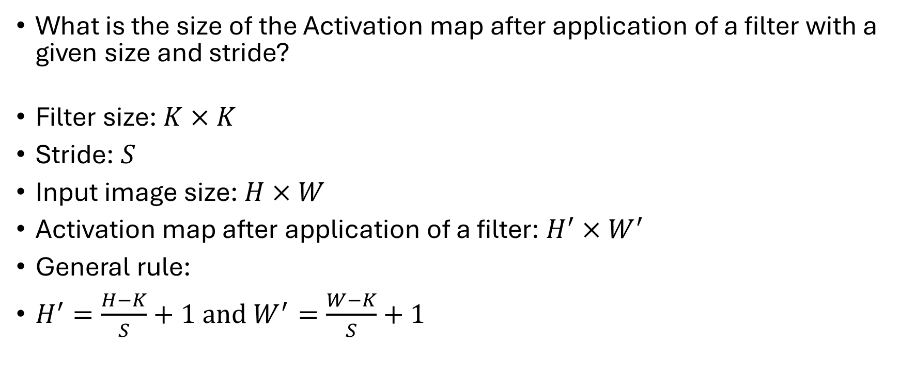
Activation map size
What is the size of the Activation map after application of a filter with a given size and stride?
Filter size: $K×K$
Stride: $S$
Input image size: $H×W$
Activation map after application of a filter: $H^{′}×W^{′}$
General rule:
$H^{′}=\frac{H−K}{S}+1 and{ W}^{′}=\frac{W−K}{S}+1$

Slide 27
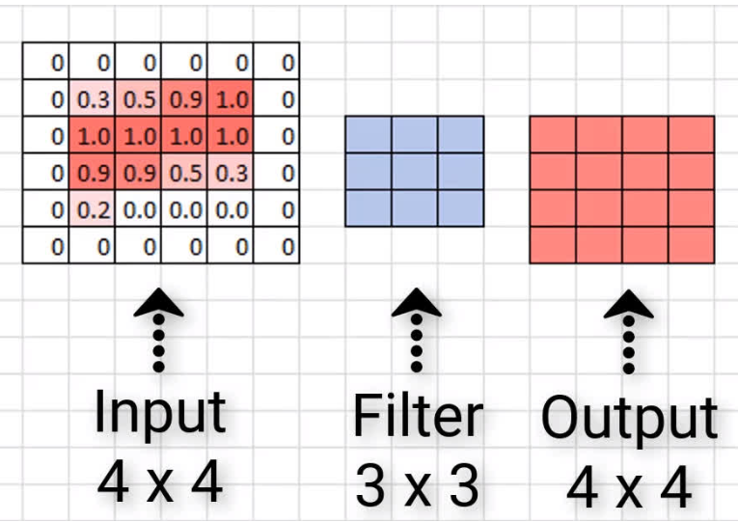
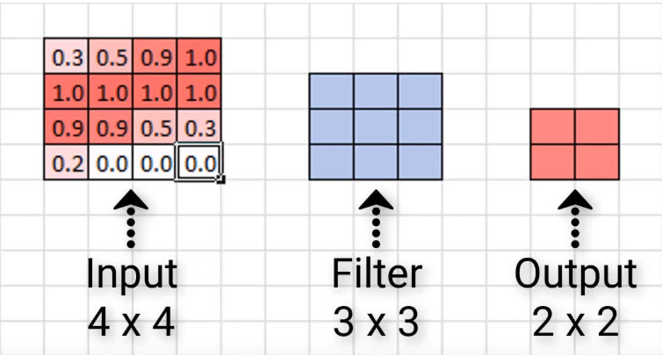
Padding
Padding means adding extra rows and columns (usually of zeros) around the edges of the input image or feature map before applying the convolution filter
Without zero padding
With zero padding

Slide 28
Padding
Padding means adding extra rows and columns (usually of zeros) around the edges of the input image or feature map before applying the convolution filter
Preserve spatial size (width and height):
Without padding, each convolution reduces the image size
Example: 4×4 input → 3×3 filter → output size = 2×2
With padding of 1 pixel → output size stays 4×4
Padding lets you design how much the size should shrink (or not shrink)

Slide 29
Padding
Type | Description
Valid (no padding) | No extra border is added; size shrinks after convolution.
Same (zero padding) | Enough zeros are added so that output size = input size (when stride = 1).
Custom padding | You can specify any number of rows/columns of zeros to add.

Slide 30
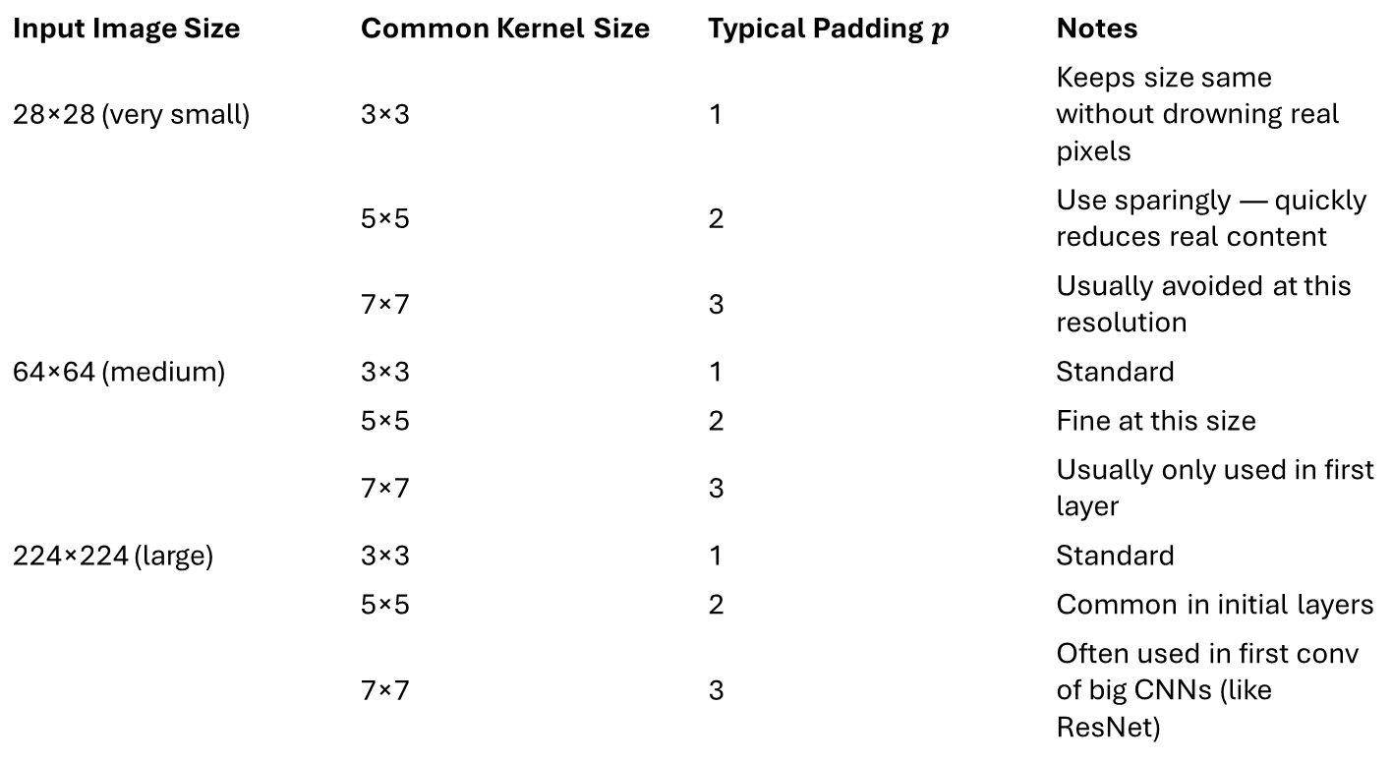
Typical Padding Choices in CNNs
Input Image Size | Common Kernel Size | Typical Padding $p$ | Notes
28×28 (very small) | 3×3 | 1 | Keeps size same without drowning real pixels
 | 5×5 | 2 | Use sparingly — quickly reduces real content
 | 7×7 | 3 | Usually avoided at this resolution
64×64 (medium) | 3×3 | 1 | Standard
 | 5×5 | 2 | Fine at this size
 | 7×7 | 3 | Usually only used in first layer
224×224 (large) | 3×3 | 1 | Standard
 | 5×5 | 2 | Common in initial layers
 | 7×7 | 3 | Often used in first conv of big CNNs (like ResNet)

Slide 31
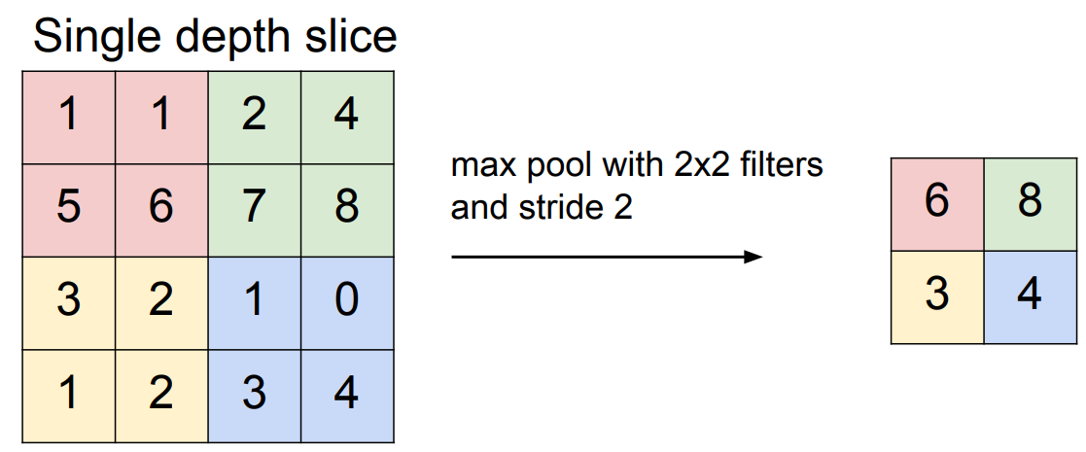
Pooling
Max pooling:

Slide 32
Pooling
Purpose: reduce spatial size → fewer parameters & faster compute
Max pooling: keeps strongest activation
Average pooling: smooths values
Trade-off: invariance vs. loss of detail
Improves invariance to small translations/rotations
Causes loss of fine spatial details
Modern CNNs sometimes replace pooling with strided convolutions

Slide 33
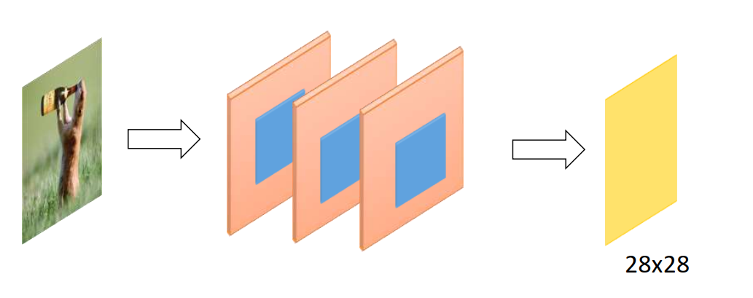
Multi-channel convolution
Multichannel convolution happens when your input has more than one channel (like an RGB image)

Slide 34
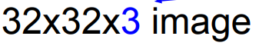
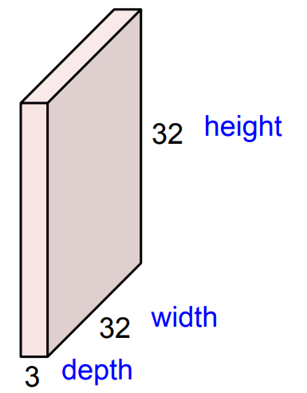
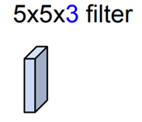
Multi-channel convolution
Suppose your input image has
height = 32, width = 32
channels = 3 (R, G, B)
Shape = 32 × 32 × 3
If you choose a 5×5 filter and input has 3 channels, then the filter has shape: 5 × 5 × 3
That is, 3 weight matrices (one for each channel), each 5×5
These are learnable parameters
Filters always extend the full depth of the input volume

Slide 35
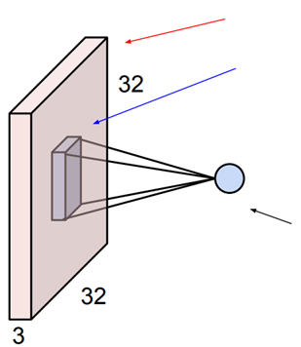
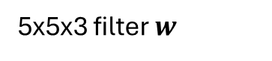
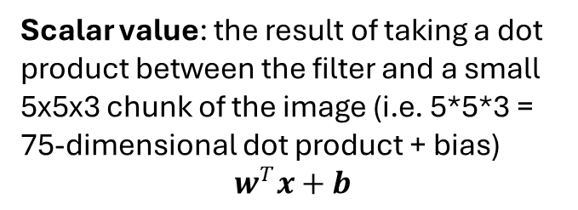
Multi-channel convolution
The filter slides across the width and height of the image
At each spatial position:
It takes the dot product of its 5×5×3 weights with the 5×5×3 patch of the image
All 3 channels are summed together to produce 1 number at that location
32x32x3 image
5x5x3 filter $w$
Scalar value: the result of taking a dot product between the filter and a small 5x5x3 chunk of the image (i.e. 5*5*3 = 75-dimensional dot product + bias)
$$w^{T}x+b$$

Slide 36
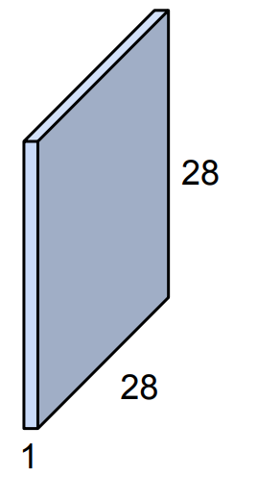
Multi-channel convolution
This produces 1 output feature map
32x32x3 image
5x5x3 filter $w$
Scalar value: the result of taking a dot product between the filter and a small 5x5x3 chunk of the image (i.e. 5*5*3 = 75-dimensional dot product + bias)
$$w^{T}x+b$$

Slide 37
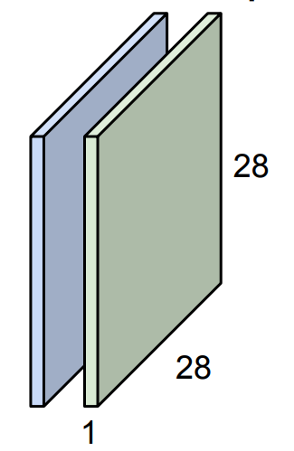
Multi-channel convolution
For a second (green) filter
32x32x3 image
5x5x3 filter $w$
Scalar value: the result of taking a dot product between the filter and a small 5x5x3 chunk of the image (i.e. 5*5*3 = 75-dimensional dot product + bias)
$$w^{T}x+b$$

Slide 38
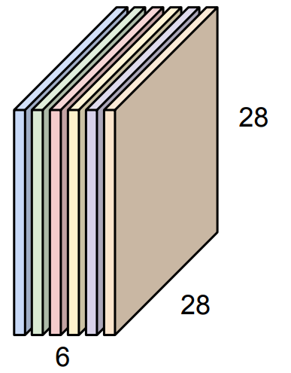
Multi-channel convolution
For N=6 such filters, we get 6 output channels
32x32x3 image
5x5x3 filter $w$
We stack these up to get a “new image” of size 28x28x6

Slide 39
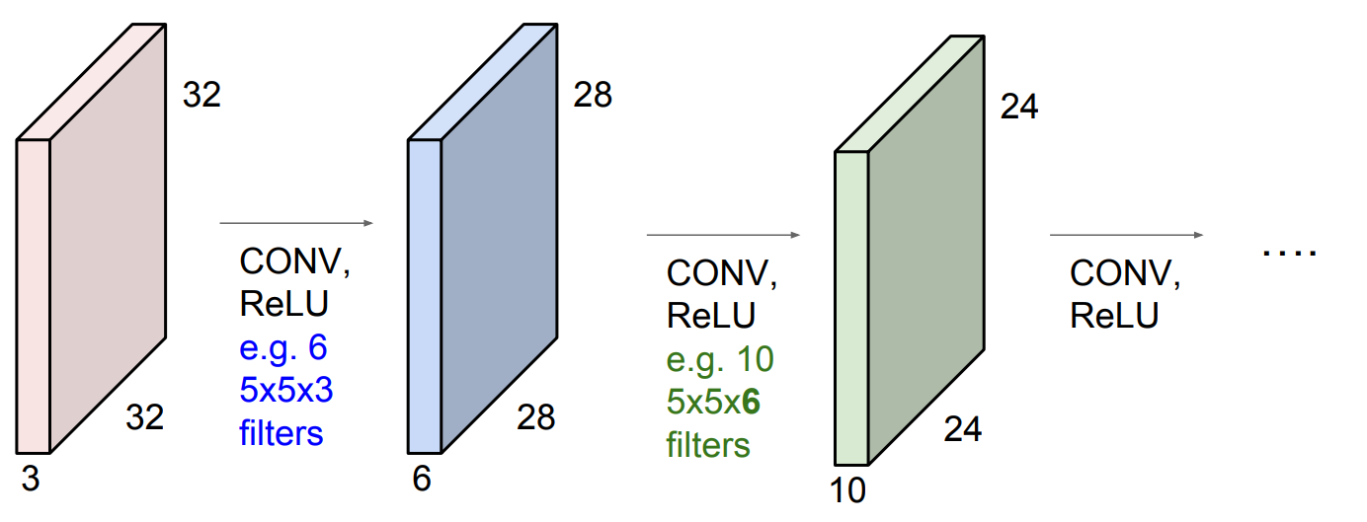
Using Multiple Conv blocks
We can stack multiples of these layers

Slide 40
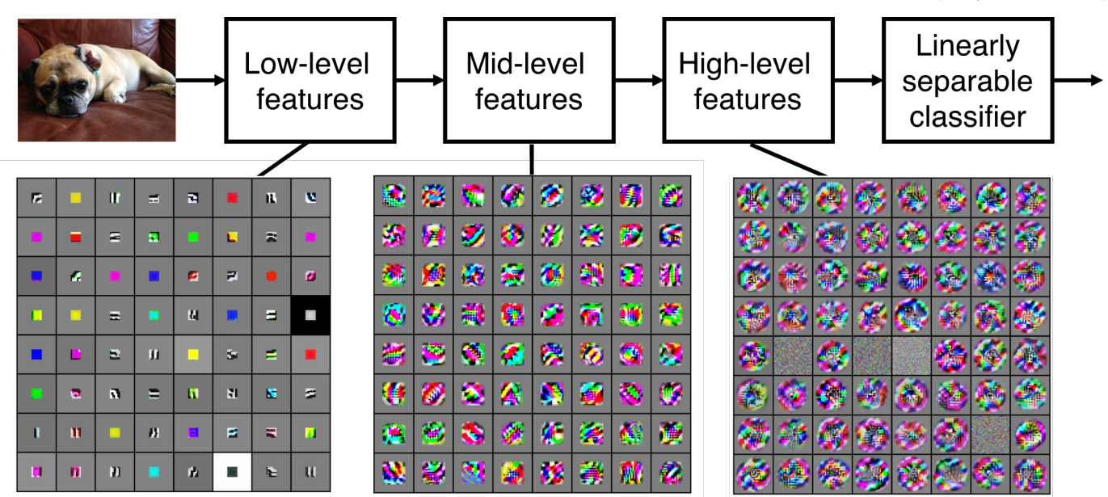
Activation map visualization
Visualization of the VGG16 model activation maps

Slide 41
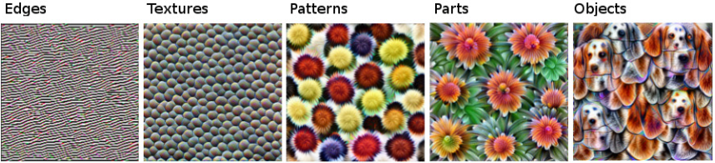
Feature Maps & Hierarchy
How CNNs Learn Visual Representations
CNNs learn hierarchical features directly from raw pixels
Early layers: Detect simple patterns like edges, lines, and corners
Middle layers: Combine simple patterns into textures, motifs, and basic shapes
Deeper layers: Recognize object parts, semantic regions, and high-level concepts (e.g. faces, wheels, eyes)

Slide 42
Feature Maps & Hierarchy
How CNNs Learn Visual Representations
This progressive abstraction enables CNNs to interpret complex images
No manual feature engineering is required
Features are learned automatically during training
Features learned by Inception V1 CNN
Trained on ImageNet data
-14 million images
-20,000 categories

